Slide 1
Enhance Soft Skills to Nurture
Competitiveness and Employability
Cognitive flexibility
PARTNER: SSE Riga

Slide 2
OBJECTIVES AND GOALS
At the end of this module you will be able to:
Identify cognitive flexibility
Recognize the role and importance of cognitive flexibility as a future skill
Recognize and use instruments to assess cognitive flexibility
Know and apply techniques to enhance cognitive flexibility

Slide 3
INDEX
1 What is cognitive flexibility and why does it matter for employability?
2 Assessing the level of cognitive flexibility
3 Enhancing and training

Slide 4
Unit 1
What is Cognitive Flexibility?
Cognitive flexibility (CF) is the human ability to adapt the cognitive processing strategies to face new and unexpected conditions in the environment (Cañas et al. 2003).
With the support of the Erasmus+ programme of the European Union. This document and its contents reflects the views only of the authors, and the Commission cannot be held responsible for any use which may be made of the information contained therein.

Slide 5
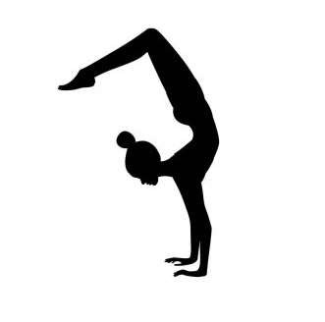
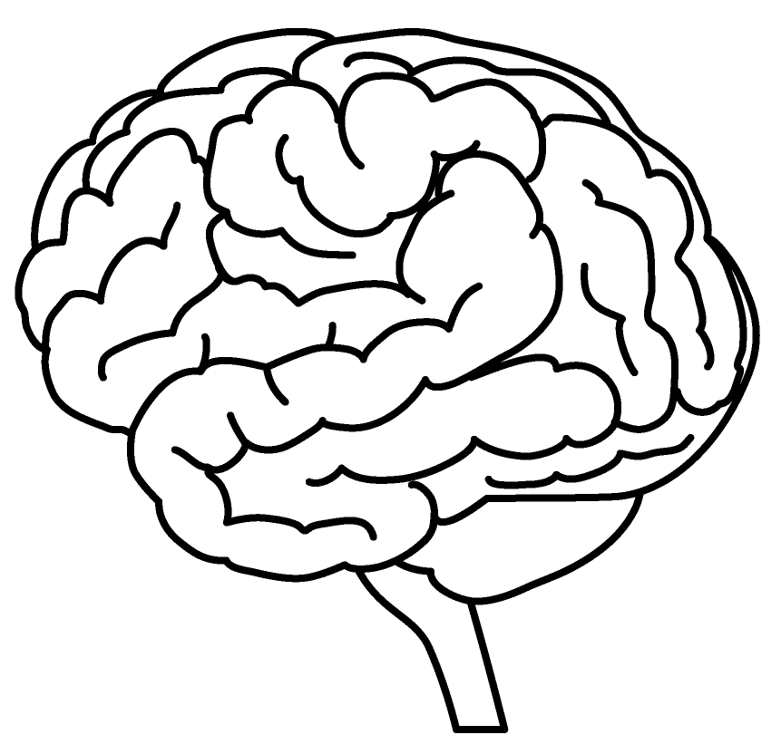
Unit 1
What is cognitive flexibility?
+
Solving Problems
Thinking Critically
Connecting Ideas
Synthesizing Information
Bending
Twisting
Thinking about things differently
Changing approaches when needed
With the support of the Erasmus+ programme of the European Union. This document and its contents reflects the views only of the authors, and the Commission cannot be held responsible for any use which may be made of the information contained therein.

Slide 6
Unit 1
What is cognitive flexibility? Alternative definitions
The brain’s ability to transition from thinking about one concept to another. The quicker you are able to switch or “shift” your thinking from one dimension to another, the greater your level of cognitive flexibility
Ability to think flexibly and to shift perspectives and approaches easily
Intrinsic property of a cognitive system often associated with the mental ability to adjust its activity and content, switch between different task rules and corresponding behavioral responses, maintain multiple concepts simultaneously and shift internal attention between them (William, 1962)
For more academic definitions of CF see Ionescu (2012)
Alternative terminology: in neuroscience, CF is sometimes referred to as “attention switching,” “cognitive shifting,” “mental flexibility, “set shifting,” and “task switching”
* Scott, William A. (December 1962). "Cognitive complexity and cognitive flexibility". Sociometry. 25 (4): 405–414. doi:10.2307/2785779. JSTOR 2785779.
** Ionescu (2012). Exploring the nature of cognitive flexibility. New ideas in psychology, 30(2), 190-200.)
With the support of the Erasmus+ programme of the European Union. This document and its contents reflects the views only of the authors, and the Commission cannot be held responsible for any use which may be made of the information contained therein.

Slide 7
Unit 1
What is cognitive flexibility?
Analogy
Changing channels on a TV:
think of the channels as “streams-of-thought” and the TV as your “brain”
If you are stuck on one channel and can’t change it – your cognition is inflexible; your stream-of-thought and/or beliefs cannot be updated or altered
If you possess a remote and can rapidly change the channel rapidly, you have good cognitive flexibility
With the support of the Erasmus+ programme of the European Union. This document and its contents reflects the views only of the authors, and the Commission cannot be held responsible for any use which may be made of the information contained therein.

Slide 8
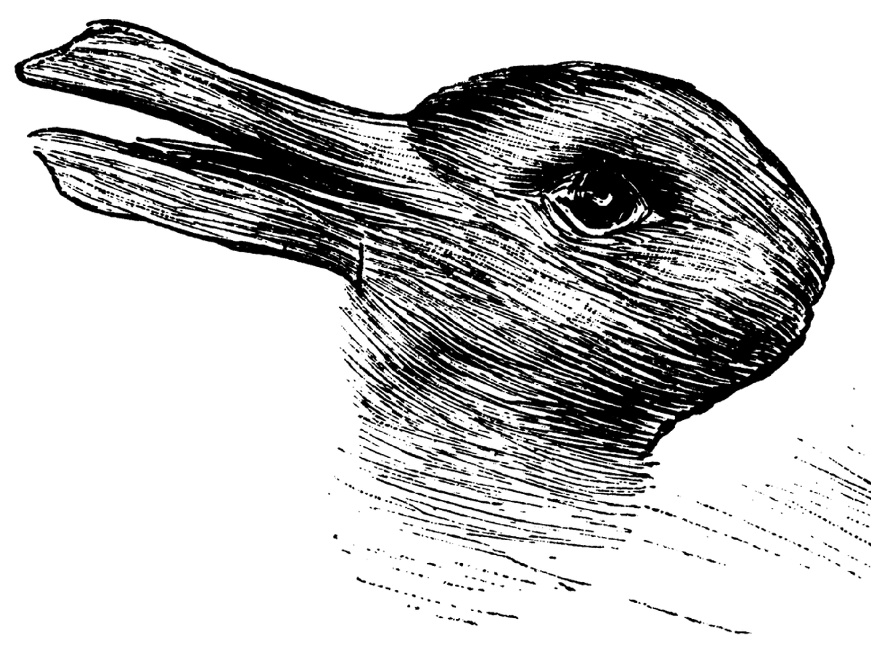
Unit 1
What do you see?
With the support of the Erasmus+ programme of the European Union. This document and its contents reflects the views only of the authors, and the Commission cannot be held responsible for any use which may be made of the information contained therein.
Notes:
Rabbit or duck?

Slide 9
Unit 1
What do you see?
With the support of the Erasmus+ programme of the European Union. This document and its contents reflects the views only of the authors, and the Commission cannot be held responsible for any use which may be made of the information contained therein.
Notes:
Faces vs vaze

Slide 10
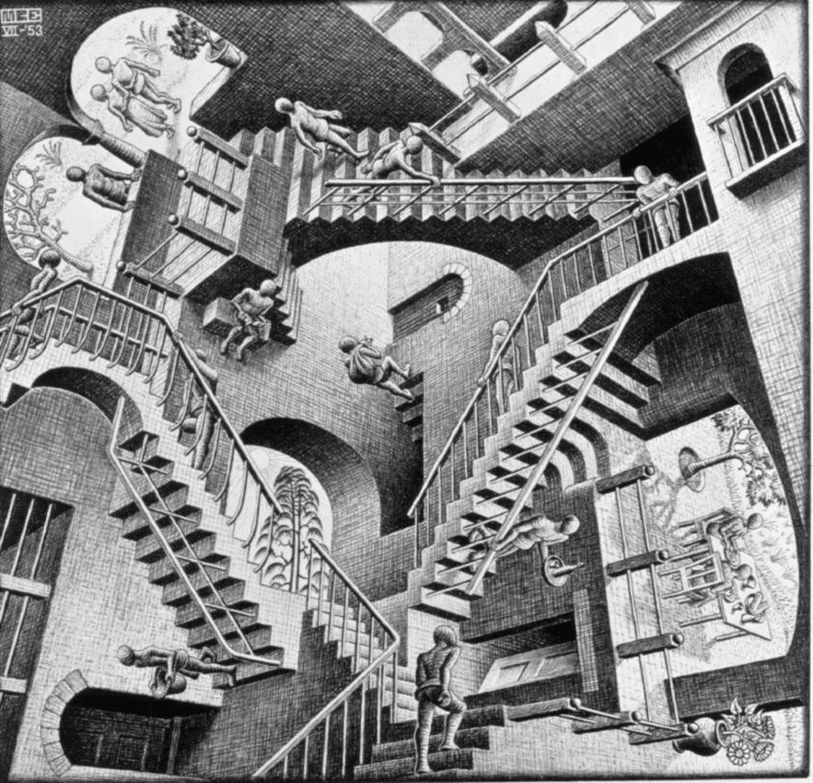
Unit 1
What do you see?:
Schroeder's Stairs
Shifting perspectives
How easy is it to switch?
Escher, M. C. "Relativity." Lithograph. 1953
With the support of the Erasmus+ programme of the European Union. This document and its contents reflects the views only of the authors, and the Commission cannot be held responsible for any use which may be made of the information contained therein.
Notes:
Faces vs vase

Slide 11
Unit 1
What is mental shifting?
Cognitive flexibility refers to the ability to adapt to a change, while mental shifting is the process that makes it possible to adapt to the change. Shifting is the main component in cognitive flexibility (often referred to as the same concept)
Characteristics of someone with strong mental shifting:
Adapts quickly to changes and new situations
Tolerates changes that occur during problem solving or carrying out a task easily
Offers alternative solutions to problems
Easily transition from one activity to another and know how to carry themselves properly in every situation
Captures various dimensions of reality, sees from different points of view, recognizes hidden relationships, hence easily finds alternative solutions to the same problem
Tolerates errors and changes, able to think about a situation from another person's point of view
Finds compromises easily
With the support of the Erasmus+ programme of the European Union. This document and its contents reflects the views only of the authors, and the Commission cannot be held responsible for any use which may be made of the information contained therein.

Slide 12
Unit 1
Cognitive flexibility and mental shifting: Examples
You're getting ready to have breakfast and you realize that there's no bread left. What do you do? Do you get mad and go to work without eating? Do you go to a café and eat there? Do you have something else for breakfast?
Cognitive shifting allows you to think about other options when your original plan is altered with an unexpected change
A good friend stops talking to you. Why is this? Is s-he mad at you?
Mental flexibility allows you to think about what has happened, and come up with a possible reason as to why they may not be talking to you. If you can think about things from other people's points of view, it helps you put yourself in their situation and think about what may have happened
You always take the same route to work. One day, it's pouring rain and you know that there will be traffic for miles. What do you do? You could take the train, you could leave the house early and try to get ahead of the traffic, or you could take other public transportation in hopes that you make it to work earlier.
Your original plans or routine were changed by an unexpected situation, but cognitive flexibility and shifting allow to you think of possible alternative solutions to help you get to work on time. You'll have to use the same abilities that you use when making a decision: experience, expectations, motivation, knowledge, and emotions.
With the support of the Erasmus+ programme of the European Union. This document and its contents reflects the views only of the authors, and the Commission cannot be held responsible for any use which may be made of the information contained therein.

Slide 13
Unit 1
Cognitive rigidity
What is cognitive rigidity?
Lack of cognitive flexibility, opposite of cognitive flexibility
Inability to change behaviour or beliefs when they are ineffective in order to reach your objective
Example
If you were asked to say words that begin with the letter "A", and the only word you could think of was ”Apple", you would be experiencing cognitive rigidity, as you would be unable to create alternatives to “Apple”
The feeling that this phenomenon causes is feeling "stuck", without being able to find a way out
Cognitive rigidity have negative consequences in daily life, in situations that require you to create alternative strategies or solutions
Why do some people have cognitive rigidity?
The human brain likes stability and tries to avoid instability however it can
With the support of the Erasmus+ programme of the European Union. This document and its contents reflects the views only of the authors, and the Commission cannot be held responsible for any use which may be made of the information contained therein.

Slide 14
Unit 1
Aspects of cognitive flexibility
Transition “stream-of-thoughts” and attention
CF most often refers to the ability to shift thoughts between multiple concepts
Updating beliefs & cognition
CF can refer to updating cognitive function as an adaptation to new information or stimuli
Multi-faceted observation
CF can refer to considering multiple elements of observation simultaneously
Deconstructing thoughts
When posed with a complex thought or problem, CF helps to deconstruct the complexity into smaller chunks. The ability to shift between specific elements of a larger problem in effort to solve it is an example of cognitive flexibility
Expanded awareness
Ability to be consciously aware of all possible choices and alternatives in a specific scenario
With the support of the Erasmus+ programme of the European Union. This document and its contents reflects the views only of the authors, and the Commission cannot be held responsible for any use which may be made of the information contained therein.

Slide 15
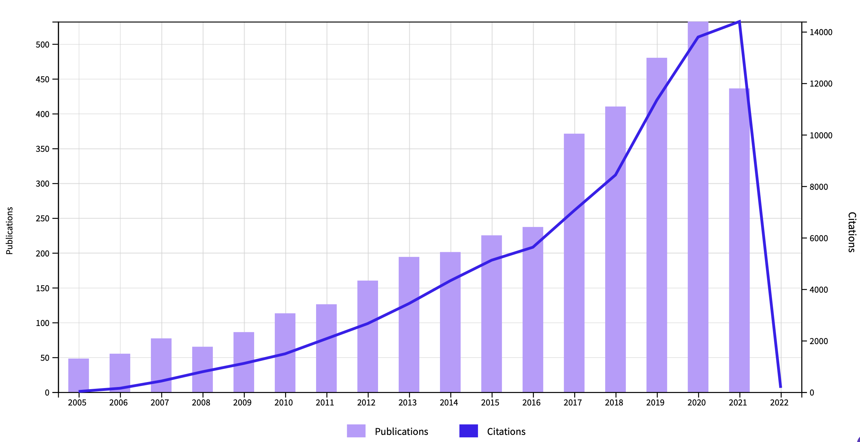
Citations of “cognitive flexibility” on Web of Science
Unit 1
Source: webofscience.com
With the support of the Erasmus+ programme of the European Union. This document and its contents reflects the views only of the authors, and the Commission cannot be held responsible for any use which may be made of the information contained therein.

Slide 16
Unit 1
Origins and development: classic authors
Formulation of “Cognitive Flexibility Theory” (1988)
by
Rand Spiro, Michigan State University
Richard Lorne Coulson, Clayton State University
Paul J. Feltovich, Florida Institute for Human and Machine Cognition
Spiro, Couldon and Feltovich remain the most cited authors in the field
→
Forthcoming 2022: Special Issue "Cognitive Flexibility: Concepts, Issues and Assessment” in Journal of Intelligence
* Spiro R., Coulson R., Feltovich P. (1988). Cognitive Flexibility Theory: Advanced Knowledge Acquisition in Ill-Structured Domains. Proceedings of The Tenth Annual Conference of the Cognitive Science Society, Montreal, August, 1988, Lawrence Erlbaum Assoc., Hillsdale, NJ, 1988.
With the support of the Erasmus+ programme of the European Union. This document and its contents reflects the views only of the authors, and the Commission cannot be held responsible for any use which may be made of the information contained therein.
Notes:
https://www.mdpi.com/journal/jintelligence/special_issues/Cognitive_Flexibility_Concepts_Issues_Assessment

Slide 17
Unit 1
The importance of cognitive flexibility
Cognitive flexibility has been associated with:
Greater resilience – better sustaining against negative life events (see Genet and Siemer, 2011)
Better quality of life and wellbeing for older individuals (Davis et al., 2010)
Creativity – ability to generate new ideas, make novel connections between ideas, new inventions. Also important in science and innovation. Eg., entrepreneurs who have created multiple companies are more cognitively flexible than managers of a similar age and IQ (Lawrence et al, 2008)
Better performing business executives (Becker and Klaner, 2021)
Protection against biases, such as confirmation bias – people who are cognitively flexible are better at recognising potential faults in themselves and using strategies to overcome these faults. (Zmigrod et al, 2016)
Affects how people cope under stress, uncertainty and new challenges (incl. adaptation under COVID-19 pandemic)
With the support of the Erasmus+ programme of the European Union. This document and its contents reflects the views only of the authors, and the Commission cannot be held responsible for any use which may be made of the information contained therein.

Slide 18
Unit 2
Measuring Cognitive Flexibility: Experimental
Experimental tests, typically age-specific due to the fact that they are either too simplistic or advanced for other age groups
Varying degrees of cognitive flexibility, i.e., not 1/0
Different people may be considered cognitively flexible – able to shift their thinking to adapt to new stimuli, but one may be able to accomplish this at a faster rate
Examples of experimental tasks to measure flexibility:
A-Not-B Task (infants)
Dimensional Change Card Sorting (DCCS) Task (toddlers)
Multiple Classification Card Sorting Task (children age 7-11)
Wisconsin Card Sorting Test (WCST) (children age 9-11)
Stroop Test (Colour-word Naming Test) (children over age 11 and adults) →
For more, see: Ionescu (2012)*
* Exploring the nature of cognitive flexibility. New ideas in psychology, 30(2), 190-200.)
With the support of the Erasmus+ programme of the European Union. This document and its contents reflects the views only of the authors, and the Commission cannot be held responsible for any use which may be made of the information contained therein.

Slide 19
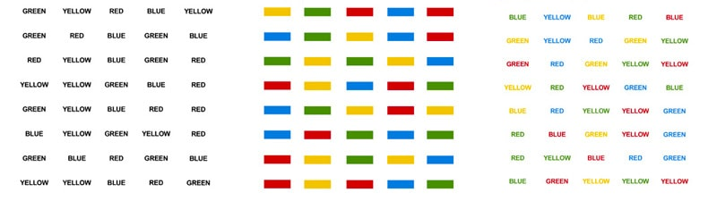
Unit 2
Stroop Test
Stroop test (after J.R Stroop, 1935) measures cognitive flexibility
Stroop effect: (in psychology) the delay in reaction time between automatic and controlled processing of information, in which the names of words interfere with the ability to name the colour of ink used to print the words.
Process: individual is presented with 3 different types of cards: a colour card, a word card, and a combo “colour-word” card. Their goal is to identify the colours on the colour card, the words on the word card, and then solely the colours on the “colour-word” card.
Try online test here or here
With the support of the Erasmus+ programme of the European Union. This document and its contents reflects the views only of the authors, and the Commission cannot be held responsible for any use which may be made of the information contained therein.

Slide 20
Unit 2
Measuring Cognitive Flexibility: Non-experimental
Non-Experimental tests
The Cognitive Control and Flexibility Questionnaire (Gabrys et al., 2018)
Based on self-assessment of statements, such as “I get easily distracted by upsetting thoughts or feelings”, “I weigh out my options before choosing how to take action”, “It’s hard for me to shift my attention away from negative thoughts or feelings” etc.
The Cognitive Flexibility Scale (CFS) (Chan et al., 2008)
Based on self-assessment of statements, such as “I avoid new and unusual situations”, “I have difficulty using my knowledge on a given topic in real life situations” etc. (alternative to previous).
Run the test online
* Gabrys, R. L., Tabri, N., Anisman, H., & Matheson, K. (2018). Cognitive control and flexibility in the context of stress and depressive symptoms: The cognitive control and flexibility questionnaire. Frontiers in Psychology, 9, 2219.
* Chan, R. C., Shum, D., Toulopoulou, T., & Chen, E. Y. (2008). Assessment of executive functions: Review of instruments and identification of critical issues. Archives of clinical neuropsychology, 23(2), 201-216.
With the support of the Erasmus+ programme of the European Union. This document and its contents reflects the views only of the authors, and the Commission cannot be held responsible for any use which may be made of the information contained therein.

Slide 21
Unit 2
Age and cognitive flexibility
Adults ages 25 and up are thought to display the greatest degree of cognitive flexibility.
The human brain is fully developed by the mid-20s, but up until the mid-20s, humans haven’t reached their full cognitive capacity. Young children display a significant degree of cognitive inflexibility due to lack of cortical development.
Following the peak brain development in the mid-20s, it is thought that cognitive flexibility can be maintained and/or enhanced for a prolonged period
The elderly tend to have significantly reduced cognitive flexibility compared to younger adults
There is a transition between mid-life adulthood and elderly adulthood in which the cognition declines and neurodegeneration sets in
With the support of the Erasmus+ programme of the European Union. This document and its contents reflects the views only of the authors, and the Commission cannot be held responsible for any use which may be made of the information contained therein.

Slide 22
Unit 3
Enhancing cognitive flexibility (for adults)
Cognitive behavioural therapy (CBT)
Evidence-based psychological therapy which helps people change their patterns of thoughts and behaviour. In CBT, the goal is to reconstruct individual’s thinking to consider more flexible options
Structure learning
The ability to extract information about the structure of a complex environment and decipher initially incomprehensible streams of sensory information. This type of learning involves similar frontal and striatal brain regions as cognitive flexibility
Training
Regularly, and purposefully, subjecting oneself to new unusual situations and different contexts trains the brain to be more flexible. Cognitive flexibility requires practice in the small moments of everyday life.
With the support of the Erasmus+ programme of the European Union. This document and its contents reflects the views only of the authors, and the Commission cannot be held responsible for any use which may be made of the information contained therein.

Slide 23
Unit 3
Non-specific ways to improve cognitive flexibility
1. Reading
Reading activates several regions of human brain, working together at the same time. It keeps brain stimulated, just like building a muscle at the gym. This improves brain function overall and therefore, cognitive flexibility as well
2. Meditation
Studies have shown that both attention and cognitive flexibility can be enhanced by the practice of mindfulness meditation. The more advanced a person is with their practice, the greater the cognitive flexibility appears to be
3. Physical exercise
The psychological benefits of exercise: boosted mood, energy, and cognitive enhancement. Regular aerobic exercise is associated with the growth of new brain cells and is an effective way to increase cognitive flexibility
4. Sleep
Rapid-eye movement sleep is associated with information processing across neural networks. REM-dreaming is associated with increased creativity and reasoning abilities. Sleep is good for the brain, and for enhancing cognitive flexibility
5. Diet
Fatty acids help improve neurotransmission, cognitive function and reduce brain inflammation. A diet full of healthy fats or specific omega-3 supplements, may increase cognitive flexibility by reducing inflammation
6. Games
Any type of game that keeps your brain challenged, whether online, board games or even word puzzles and ad libs, can help build neural pathways. Having these fortified mental reserves can help delay cognitive decline as we age
With the support of the Erasmus+ programme of the European Union. This document and its contents reflects the views only of the authors, and the Commission cannot be held responsible for any use which may be made of the information contained therein.

Slide 24
Thank you!

