Slide 1


Enhance Soft Skills to Nurture
Competitiveness and Employability
Critical Thinking for professional development:
EntreComp’s “Ideas & Opportunities”
PARTNER: IHF asbl

Slide 2
OBJECTIVES AND GOALS
At the end of this module you will be able to:
Get more familiar with the EntreComp Framework…
…the official EU framework for education and training on sense of initiative and entrepreneurial competences
Have a deepen look into EntreComp
Three Training Areas: IDEAS & OPPORTUNITIES, RESOURCES, INTO ACTION
Understand how Critical Thinking is framed into EntreComp
IDEAS & OPPORTUNITIES’ pillar for Critical Thinking
Experiment with operative frameworks for Critical Thinking
Analysis → Inference → Evaluation

Slide 3
INDEX
Unit 1: An introduction to EntreComp
Opportunities for capacity building
A brief timeline of the framework
Eight competences for Long Life Learning
A deepen look into EntreComp
Unit 2: From Soft to Employability Skills
A look into the future
The future of Jobs
Top 10 skills for employability
EntreComp approach to Critical Thinking
Unit 3: Critical Thinking in a nutshell
IPO: Input → Process → Output
The “Critical” element in IPO
IPO in team’s dynamics

Slide 4


Unit 1
An introduction to the Entrepreneurial Competence Framework (EntreComp)
In the context of this module, you will be introduced to the official European Competence Framework for education and training on entrepreneurial competences and what use you can make of it talking about Critical Thinking.
Opportunities for upskilling and capacity building
Although formally conceived to enhance, foster and sustain the entrepreneurial spirit(s) of EU citizens, the EntreComp Framework responses to a much broader landscape of needs and opportunities for employability and upskilling, i.e., lifelong learning (LLL) opportunities.
In other words, the EntreComp can be strategically referred to all domains of education and training as many of the competences listed by the framework are equally relevant and meaningful for professional career development, sense of initiative and self-reliability, development of soft-skill – including Critical Thinking.
With the support of the Erasmus+ programme of the European Union. This document and its contents reflects the views only of the authors, and the Commission cannot be held responsible for any use which may be made of the information contained therein.

Slide 5
Unit 1
A brief timeline of the framework
To track the origins of the EntreComp Framework, we have to go back to December 2006:
Recommendation of the European Parliament and of the Council of 18 December 2006 on key competences for lifelong learning
This policy document identifies eight key competences of interest to boost the excellence of LLL programmes implemented at EU level, and their overall responsiveness to the emerging social and economic challenges of the given historical period.
By the term competences, the European Parliament refers to:
“…a combination of knowledge, skills and attitudes appropriate to the context. Key competences are those which all individuals need for personal fulfilment and development, active citizenship, social inclusion and employment”.
With the support of the Erasmus+ programme of the European Union. This document and its contents reflects the views only of the authors, and the Commission cannot be held responsible for any use which may be made of the information contained therein.

Slide 6
Unit 1
Eight key competences for LongLife Learning (LLL)
The aforementioned competences are the following:
Communication in the mother tongue
Communication in foreign language
Essentials in STEM disciplines
Digital Competences
Learning to learn
Social and civic competences
Sense of initiative and entrepreneurship
Cultural awareness and expression
With the support of the Erasmus+ programme of the European Union. This document and its contents reflects the views only of the authors, and the Commission cannot be held responsible for any use which may be made of the information contained therein.

Slide 7
Unit 1
7. Sense of initiative and entrepreneurship
Sense of initiative and entrepreneurship (LLL competence no.7) is described as the person’s ability to:
“…turn ideas into action [helping] individuals in the workplace in being aware of the context and [surrounding] opportunities”.
Furthermore, this same competence refers to:
“…the ability to identify available opportunities for personal, professional and/or business activities, including ‘bigger picture’ issues that provide the context in which people live and work, such as a broad understanding of the workings of the economy, and the opportunities and challenges facing an employer or organisation”.
With the support of the Erasmus+ programme of the European Union. This document and its contents reflects the views only of the authors, and the Commission cannot be held responsible for any use which may be made of the information contained therein.

Slide 8
Unit 1
Linking Critical Thinking to competence no.7
From here, we can start seeing some clear linkages with what it is commonly understood as “Critical Thinking”, meaning:
“… the intellectually disciplined process of actively conceptualizing, applying, analysing, synthesizing, and/or evaluating information gathered from, or generated by, observation, experience, reflection, reasoning, or communication, as a guide to belief and action”.
Source: Michael Scriven & Richard Paul, 8th Annual International Conference on Critical Thinking and Education Reform, 1987.
In both contexts, we are referring to an ability/process in which, based on some inputs, people reacts by assigning meanings to what they experience and finetune their thoughts/actions accordingly.
With the support of the Erasmus+ programme of the European Union. This document and its contents reflects the views only of the authors, and the Commission cannot be held responsible for any use which may be made of the information contained therein.

Slide 9
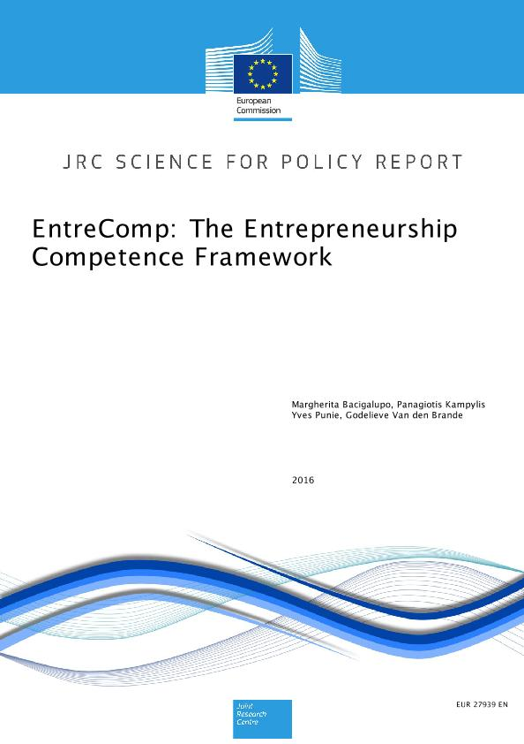
Unit 1
The publication of the EntreComp Framework
The EntreComp Framework came exactly ten years after EU Parliament's recommendations.
Competence no.7 as we know it has been “splitted” into a three-dimension training areas including 15 competences – five for each area.
As of today, the EntreComp framework remains – together with DigComp and LifeComp – the most reliable and robust reference model for education and training at EU level
With the support of the Erasmus+ programme of the European Union. This document and its contents reflects the views only of the authors, and the Commission cannot be held responsible for any use which may be made of the information contained therein.

Slide 10
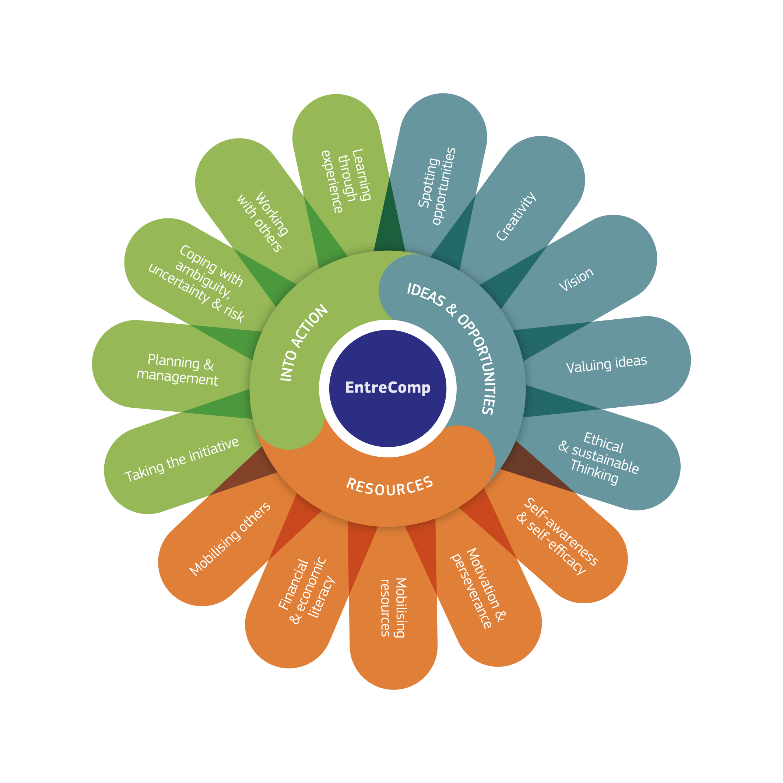
The EntreComp Framework, a visual representation
With the support of the Erasmus+ programme of the European Union. This document and its contents reflects the views only of the authors, and the Commission cannot be held responsible for any use which may be made of the information contained therein.

Slide 11
Unit 1
Training areas and competences: a deepen look into EntreComp
As we mentioned already, the EntreComp framework includes 15 competences divided equally among three training areas that are closely interrelated each other’s:
IDEA & OPPORTUNITIES
RESOURCES
INTO ACTION
Once again, it is important to reiterate the fact that the EntreComp’s design conceived Entrepreneurship not as a profession, but rather as a competence:
Entrepreneurial competences apply to all domain of social and professional life, included employability, professional empowerment and even active citizenship.
With the support of the Erasmus+ programme of the European Union. This document and its contents reflects the views only of the authors, and the Commission cannot be held responsible for any use which may be made of the information contained therein.

Slide 12
Unit 1
IDEA & OPPORTUNITIES
Competence | Hint | Description
1.1 Spotting opportunities | Use your imagination and abilities to identify opportunities for creating value | Identify and seize opportunities to create value by exploring the social, cultural and economic landscape Identify needs and challenges that need to be met Establish new connections and bring together scattered elements of the landscape to create opportunities to create value
1.2 Creativity | Develop creative and purposeful ideas | Develop several ideas and opportunities to create value including better solutions to existing and new challenges Explore and experiment with innovative approaches Combine knowledge and resources to achieve valuable effects
1.3 Vision | Work towards your vision of the future | Imagine the future Develop a vision to turn ideas into action Visualise future scenarios to help guide effort and action
1.4 Valuing Idea | Make the most of ideas and opportunities | Judge what value is in social, cultural and economic terms Recognise the potential an idea has for creating value and identify suitable ways of making the most out of it
1.5 Ethical and Sustainable thinking | Assess the consequences and impact of ideas, opportunities and actions | Assess the consequences of ideas that bring value and the effect of entrepreneurial action on the target community, the market, society and the environment Reflect on how sustainable long-term social, cultural and economic goals are, and the course of action chosen Act responsibly
With the support of the Erasmus+ programme of the European Union. This document and its contents reflects the views only of the authors, and the Commission cannot be held responsible for any use which may be made of the information contained therein.

Slide 13
Unit 1
RESOURCES
Competence | Hint | Description
2.1 Self-awareness and self-efficacy | Believing in yourself and keep developing | Reflect on your needs, aspirations and wants in the short, medium and long term Identify and assess your individual and group strengths and weaknesses Believe in your ability to influence the course of events, despite uncertainty, setbacks and temporary failures
2.2 Motivation and perseverance | Stay focused and don’t give up | Be determined to turn ideas into action and satisfy your need to achieve Be prepared to be patient and keep trying to achieve your long-term individual or group aims Be resilient under pressure, adversity, and temporary failure
2.3 Mobilising resources | Gather and manage the resources you need | Get and manage the material, non-material and digital resources needed to turn ideas into action Make the most of limited resources Get and manage the competences needed at any stage, including technical, legal, tax and digital competences
2.4 Financial and Economic literacy | Develop financial and economic know-how | Estimate the cost of turning an idea into a value-creating activity Plan, put in place and evaluate financial decisions over time Manage financing to make sure your value-creating activity can last over the long term
2.5 Mobilising others | Inspire, enthuse and get others on board | Inspire and enthuse relevant stakeholders Get the support needed to achieve valuable outcomes Demonstrate effective communication, persuasion, negotiation and leadership
With the support of the Erasmus+ programme of the European Union. This document and its contents reflects the views only of the authors, and the Commission cannot be held responsible for any use which may be made of the information contained therein.

Slide 14
Unit 1
INTO ACTION
Competence | Hint | Description
3.1 Taking the initiative | Go for it | Initiate processes that create value Take up challenges Act and work independently to achieve goals, stick to intentions and carry out planned tasks
3.2 Planning and Management | Priorities, organize and follow-up | Set long-, medium- and short-term goals Define priorities and action plans Adapt to unforeseen changes
3.3 Coping with uncertainty, ambiguity & risk | Make decision dealing with uncertainty, ambiguity and risk | Make decisions when the result of that decision is uncertain, when the information available is partial or ambiguous, or when there is a risk of unintended outcomes Within the value-creating process, include structured ways of testing ideas and prototypes from the early stages, to reduce risks of failing Handle fast-moving situations promptly and flexibly
3.4 Working with others | Team up, collaborate and network | Work together and co-operate with others to develop ideas and turn them into action Network Solve conflicts and face up to competition positively when necessary
3.5 Learning through experience | Learn by doing | Use any initiative for value creation as a learning opportunity Learn with others, including peers and mentors Reflect and learn from both success and failure (your own and other people’s)
With the support of the Erasmus+ programme of the European Union. This document and its contents reflects the views only of the authors, and the Commission cannot be held responsible for any use which may be made of the information contained therein.

Slide 15
Unit 1
What follows…
In the context of this training module – and in consideration also of the underlying competences that we are dealing with – we will orientate your focus towards the first pillar, the one relating to IDEAS & OPPORTUNITIES.
Note that the EntreComp does not make specific reference to Critical Thinking, but the whole framework tackles Critical Thinking-related dimension from many different angles.
The most tangible cross reference appears to be with the competences belonging to IDEAS & OPPORTUNITIES. In the next unit we will go into further details on each one of them to as to track tangible connections with Critical Thinking, and most importantly, Critical Thinking at the use of employability.
With the support of the Erasmus+ programme of the European Union. This document and its contents reflects the views only of the authors, and the Commission cannot be held responsible for any use which may be made of the information contained therein.

Slide 16
Unit 2
Critical Thinking among the most-desired competences for employability
Nowadays, as the automatization of tasks and functions is slowly replacing both “manual” an “intellectual” workforce, your opportunities to access the job market are increasingly depending on soft and relational skills.
Notes for your consideration: From Soft to Employability Skills
Technical proficiency and effectiveness in the work place comes, firstly and foremost, from practices, exercise and experiences/lessons learned based on a trial-and-and-error approach. During interviews, employers do not have enough information to assess candidate profile’s and his/her potential performance in the workplace.
Furthermore, most of times the jobs you’re applying for requires specific knowledge/know-how that you might not have acquired during your formal education (simply because not included in the curricula).
So how do employers orientate their evaluation of your profile?...
With the support of the Erasmus+ programme of the European Union. This document and its contents reflects the views only of the authors, and the Commission cannot be held responsible for any use which may be made of the information contained therein.

Slide 17
Unit 2
A look into the future
Employers are perfectly aware that new recruits – specifically recent graduates – require in-depth education and training with focus on their future roles and responsibilities before being fully autonomous and independent.
During the first interview, rather than focusing on what you can do, they will be seeking for other information that might not be related to your education at all.
This kind of information, represents the very origin of the ESSENCE project and the assumptions on which it is rooted.
With the support of the Erasmus+ programme of the European Union. This document and its contents reflects the views only of the authors, and the Commission cannot be held responsible for any use which may be made of the information contained therein.

Slide 18
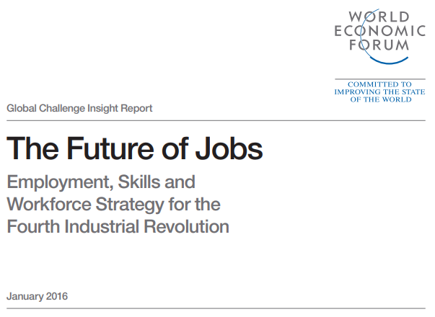
Unit 2
The Future of Jobs
Back in 2016, the World Economic Forum predicted a major shift by 2020 in the “top 10 skills” for employability, recruitment, career development and business competitiveness.
According to the report, soft and relational skills are essential for new graduates and HE students to enter the job market as recruiters and employers develop new sophisticated models to assess the “human” profile of candidates (i.e., ability to work with others, sense of initiative, reliability and trustworthiness, etc.).
With the support of the Erasmus+ programme of the European Union. This document and its contents reflects the views only of the authors, and the Commission cannot be held responsible for any use which may be made of the information contained therein.

Slide 19
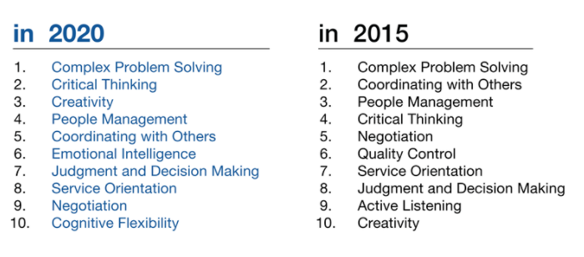
Unit 2
Top 10 skill for employability
Source: Future of Jobs Report, World Economic Forum
With the support of the Erasmus+ programme of the European Union. This document and its contents reflects the views only of the authors, and the Commission cannot be held responsible for any use which may be made of the information contained therein.

Slide 20
Unit 2
An EntreComp approach to Critical Thinking
When we think about it, finding a job – or the opportunity for an interview with a company that you would like to work for – is a process that resemble EntreComp’s design:
Identify IDEAS & OPPORTUNITIES to achieve that objective
mobilizing your RESOURCES to nurture even further your sense of initiative
and finally, putting yourself INTO ACTION
So at first, you need to think critically on how to plan, strategize and move on with your job-hunting…not by chance, according to many, finding a job is a job per se.
With the support of the Erasmus+ programme of the European Union. This document and its contents reflects the views only of the authors, and the Commission cannot be held responsible for any use which may be made of the information contained therein.

Slide 21
Unit 2
1. Spotting opportunities
Spotting opportunities for employability is the very first task you are require to comply with so as to maximize your chances of employability.
Applying Critical Thinking to spotting opportunities for employability means analyzing, inferencing and evaluating relevant information (data, statistics, etc.) emerging from the job market: which is the industry with the highest growth potential? Where are located its key players? Etc. This qualitative and quantitative phenomenon should be cross-referenced with your personal aspirations, motivations and achievements. Threats and opportunities from the market remain subjective from person to person.
Take some time to reflect on what drives your interests, what stimulate your curiosity, what might be a personal talent of yours from which to leverage on…
With the support of the Erasmus+ programme of the European Union. This document and its contents reflects the views only of the authors, and the Commission cannot be held responsible for any use which may be made of the information contained therein.

Slide 22
Unit 2
2. Creativity
Very often, when it comes to job hunting, the one-solution-fits-all approach can lead very easily to negative effects.
Unfortunately, at times, the job-market becomes an extremely competitive arena. On a daily basis, hundreds of applications flood the “work with us” inbox of companies and organization, in order to really stand out from masses you need to be very creative in your approach.
Luckily for you, LinkedIn provides for new numerous and exciting opportunities to network with people that can be of great support. However, this does not implies that the task it’s easier…
Seek for guidance and feedbacks, do your research and learn from experts key tips and hints on how to “relate” with employers, based also on companies’ recruiting process. In other words, do not stop assimilating external inputs.
With the support of the Erasmus+ programme of the European Union. This document and its contents reflects the views only of the authors, and the Commission cannot be held responsible for any use which may be made of the information contained therein.

Slide 23
Unit 2
3. Vision
Once new opportunities are spotted and you have a plan to stand out and valorizing your strengths, go back to your “inner” self so as to pinpoint those key elements that will influence and impact on your future decisions.
This is really about to put on the scale, on one hand your passions, aspirations, desires and expectations, on the other, concrete opportunities that surrounds you.
You need to be aware that you might not be able to access your “first choice” option (the one that you were really dreaming for) fresh of university. Job-hunting can put you in compromise situations with or without your will…be sincere with yourself and ask you how would you deal with, how many steps would you need to get closer to what you were actually pursuing.
With the support of the Erasmus+ programme of the European Union. This document and its contents reflects the views only of the authors, and the Commission cannot be held responsible for any use which may be made of the information contained therein.

Slide 24
Unit 2
4. Valuing ideas
Now that you have a semi-defined roadmap with new and consolidated coordinates orienteering your focus, you can start to narrow down even further your targets of reference – the ones that seems compliant and coherent with your personal expectations, empowerment and professional development opportunities, etc.
Considering all the multiple alternative you might have, try to highlight and process inputs by looking at the most that you can make out of each one of them.
Each item (i.e., salary) will be assigned to a value that is measured on a numerical scale (for instance, 1 = very disadvantageous; 5 = very advantageous), at the end of process each option will present a certain score. Of course, the higher the score, the higher the appealing of the solution.
Math should not dictate your final decision, but it will certainly be of support…
With the support of the Erasmus+ programme of the European Union. This document and its contents reflects the views only of the authors, and the Commission cannot be held responsible for any use which may be made of the information contained therein.

Slide 25
Unit 2
5. Ethical and Sustainable Thinking
When we talk about job-hunting, employment and professional development, let’s not forget that once you will be embraced by the ecosystem, your actions will impact someone somewhere near you.
After acquiring enough responsibility and experience, there will be a moment in which your vote might decide the output of a delicate decision. This scenario can make quite a big difference if you work in the healthcare sector, defence, finance, and more in general, industries that impact societies and economies at large.
While valuing the different alternative for employability, take into the equation your accountability and potential exposures to unpleasant situations… will you be ready and mentally prepared to cope with the consequences?
With the support of the Erasmus+ programme of the European Union. This document and its contents reflects the views only of the authors, and the Commission cannot be held responsible for any use which may be made of the information contained therein.

Slide 26
Unit 3
Critical Thinking in a nutshell: merging new takeaways and recommendations
In this last Unit, we will look at interesting and defining features of Critical Thinking so as to sustain you in better familiarise with the notion and start experimenting with new “critical” approaches applied to real-life scenarios.
A formula for Critical Thinking
Back in the previous unit, we mentioned the fact that an application of Critical Thinking in its very essentials follows a three-stage approach as follows:
Analysis
Inference
Evaluation
With the support of the Erasmus+ programme of the European Union. This document and its contents reflects the views only of the authors, and the Commission cannot be held responsible for any use which may be made of the information contained therein.

Slide 27
Unit 3
Analysis → Inference → Evaluation
Out of all the conceptual models relied on to frame Critical Thinking as a cognitive function, the one here proposed is also the most common and reliable one.
Analysis pertains to the absorbing process from the external environment of insight, inputs and information that are relevant to decode and interpret “what is happening” in that given moment.
Inference pertains to establishing cause-effect correlations upon what we are experiencing based on assumptions and following deductions.
Evaluation pertains to assigning meanings and recognizable patterns of thought and actions as long as they are predictable.
With the support of the Erasmus+ programme of the European Union. This document and its contents reflects the views only of the authors, and the Commission cannot be held responsible for any use which may be made of the information contained therein.

Slide 28
Unit 3
IPO: Input → Process → Output
What we just saw does not differ significantly from a well-known model applied in software engineering as well as in psychology.
The IPO model has been in fact – and still is – the core theoretical framework of cognitive psychology (a.k.a. Cognitivism), a branch of the discipline involved in the research filed of memory and learning. When interfacing with social systems, people rely on the IPO model to orientate their actions/reaction on constant basis, without even being aware of it…
INPUT → Trigger of the action/reaction
PROCESS → Computation of the input (based on external factors, cultural background, experience, etc.)
OUTPUT → Response to the input (as adequate, coherent and consistent as possible)
With the support of the Erasmus+ programme of the European Union. This document and its contents reflects the views only of the authors, and the Commission cannot be held responsible for any use which may be made of the information contained therein.

Slide 29
Unit 3
The “Critical” element in IPO
Some might argue that Critical Thinking is an intrinsic element of the P as here more than in other cycles, intervenes an in-depth evaluation and assessment of the surroundings.
However, Critical Thinking permeates the entire process as people can “critically discern” the inputs that are of greater relevance for them as well as the content, structure and variability of the output.
We experienced already this fluidity of Critical Thinking across the stages of a process when we re-built the IDEAS & OPPORTUNITIES’ flow. From Spotting Opportunities to Sustainability, Critical Thinking took different shapes and form while moving across the whole training area.
With the support of the Erasmus+ programme of the European Union. This document and its contents reflects the views only of the authors, and the Commission cannot be held responsible for any use which may be made of the information contained therein.

Slide 30
Unit 3
IPO in team’s dynamics
When applied to formal organization, the IPO model looks mainly into:
Strategic Planning (i.e., budgeting)
Monitoring and Evaluation
Auditing
Risk Management
Communication and PR
Networking and STKH Management
People management (i.e., trust-building, resolution of conflicts)
It is correct to say that what constitutes and Input in specific situations, might result as Output if contextualized in another.
With the support of the Erasmus+ programme of the European Union. This document and its contents reflects the views only of the authors, and the Commission cannot be held responsible for any use which may be made of the information contained therein.

Slide 31
Unit 3
Critical Thinking also as…
One’s personal commitment to replicate and adjusts successful and adequate behaviors to navigate the social/relational ecosystem
Knowledge, know-how and internal beliefs contributing to the generation and processing of (new) skills
With the support of the Erasmus+ programme of the European Union. This document and its contents reflects the views only of the authors, and the Commission cannot be held responsible for any use which may be made of the information contained therein.

Slide 32
Summing Up
The EntreComp Framework to nurture your entrepreneurial attitudes
Critical Thinking in EntreComp: IDEAS & OPPORTUNITIES’ pillar
Critical Thinking from “soft” to “employability” skills
Analysis → Inference → Evaluation
IPO: Input → Process → Output
With the support of the Erasmus+ programme of the European Union. This document and its contents reflects the views only of the authors, and the Commission cannot be held responsible for any use which may be made of the information contained therein.

Slide 33
Thank you!

