Slide 1


Enhance Soft Skills to Nurture
Competitiveness and Employability
Creativity
PARTNER: UNIDU

Slide 2
OBJECTIVES AND GOALS
At the end of this module you will be able to:
Define creativity, outline its importance and identify its components
Explain the 4P model of creativity and discuss the types of creativity
Understand how to build creative teams
Define, explain and apply most commonly used creativity techniques
Explain the framework of design thinking

Slide 3

INDEX
Unit 2
Unit 3
Defining creativity
Team Creativity and Creativity Techniques
Design Thinking
What is creativity? The importance of creativity
Components of creativity and the 4P model of creativity
Types of creativity
Personal and Team Creativity
Creativity Barriers
Creativity techniques
Brainstorming, Brainwriting, Six Thinking hats…
Design Thinking Framework
Five themes characteristic for Design Thinking
Four kinds of design Thinking

Slide 4


CREATIVITY
  1.1 Unit name: DEFINING CREATIVITY
1.1.1 Section 1: What is creativity? The importance of creativity
1.1.2. Section 2: Components of creativity and the 4P model of creativity
1.1.3. Section 3: Types of creativity
  1.2 Unit name: TEAM CREATIVITY AND CREATIVITY TECHNIQUES
1.2.1 Section 1: Overcoming personal barriers to creativity
1.2.2 Section 2: Team creativity
1.2.3 Section 3: Creativity in the workplace
    1.2.4 Section 4: Creativity Techniques
  1.3 Unit name: DESIGN THINKING
1.3.1 Section 1: Design Thinking Framework
1.3.2 Section 2: Design Thinking Models
With the support of the Erasmus+ programme of the European Union. This document and its contents reflects the views only of the authors, and the Commission cannot be held responsible for any use which may be made of the information contained therein.

Slide 5
Unit 1
What is creativity?
Being creative is a necessity in today's rapidly changing and challenging world
Creativity is the key to success in almost all aspects of life, personal and professional
Creativity is important to society and it exerts a powerful influence on all aspects of society
In simple words, creativity is the combination of two core elements:
(1) novelty, newness, or originality and
(2) task appropriateness, usefulness, or meaningfulness.
With the support of the Erasmus+ programme of the European Union. This document and its contents reflects the views only of the authors, and the Commission cannot be held responsible for any use which may be made of the information contained therein.

Slide 6
Unit 1
Definitions of creativity
There are countless definitions of creativity and it is difficult to settle on a single one:
"the ability to produce or use original and unusual ideas” (The Cambridge Dictionary); "the ability to create" and "the quality of being creative” (The Merriam-Webster Dictionary)
"creativity is the ability to produce work that is both novel (i.e., original, unexpected) and appropriate (i.e., useful, adaptive concerning task constraints)” (Sternberg and Lubart, 1999, p. 3)
"creativity is the production of something that is both new and truly valuable” (Rothenberg, 1990, p. 5)
”creativity is the process of developing an original, novel, yet appropriate response to a problem” (Chaudhary, 2018, p. 171)
With the support of the Erasmus+ programme of the European Union. This document and its contents reflects the views only of the authors, and the Commission cannot be held responsible for any use which may be made of the information contained therein.

Slide 7
Unit 1
Investment Theory of Creativity
Sternberg and Lubart (1991, 1992) have proposed the Investment Theory of Creativity, which states that creativity is in large part a decision to buy low and sell high in the world of ideas.
Creative people, like good investors, develop ideas that are considered novel and perhaps even a little ridiculous at the time, i.e., they "buy low".
Once their ideas have gained some acceptance, creatives "sell high”, reap the profits from their good idea, and move on to the next unpopular idea.
With the support of the Erasmus+ programme of the European Union. This document and its contents reflects the views only of the authors, and the Commission cannot be held responsible for any use which may be made of the information contained therein.

Slide 8
Unit 1
The importance of creativity
Individual level
solving problems at work and in daily life
Societal level
new scientific knowledge, new movements in the arts, new inventions
Economic
importance
new products and services create jobs
With the support of the Erasmus+ programme of the European Union. This document and its contents reflects the views only of the authors, and the Commission cannot be held responsible for any use which may be made of the information contained therein.

Slide 9
Unit 1
Five components of creativity: Sternberg and Lubart (1992)
Intrinsic motivation - the quality of being driven by interest, satisfaction, and challenge
Expertise - a well-developed knowledge base that provides the ideas, images, and expressions
Imaginative thinking skills - the ability to see things in new ways, recognize patterns, and make connections
A venturesome personality - seeks out new experiences, tolerates ambiguity and risk, and persistently overcomes obstacles
Creative environment - an innovative environment stimulates, supports and refines creative ideas
With the support of the Erasmus+ programme of the European Union. This document and its contents reflects the views only of the authors, and the Commission cannot be held responsible for any use which may be made of the information contained therein.

Slide 10
Unit 1
Important resources for a person's creative production
a set of intellectual skills (the ability to see problems in new ways and to go beyond ordinary ideas; the ability to identify which ideas are worth pursuing; and the ability to convince others of the value of one's ideas)
knowledge of the field (although too much knowledge can hinder the generation of new ideas)
a personality that allows you to think independently, which is necessary if you are going to buck the crowd and advocate ideas that most others disagree with
an environment that supports and rewards creative ideas.
Source: Sternberg and Lubart (1995)
With the support of the Erasmus+ programme of the European Union. This document and its contents reflects the views only of the authors, and the Commission cannot be held responsible for any use which may be made of the information contained therein.

Slide 11
Unit 1
Characteristics of creative people: Adapted from Cloninger and Mengert (2010)
Cognitive characteristics | Personality characteristics | Domain-related characteristics (e.g. young writers)
Metaphorical thinking | Novelty-seeking | Playfulness with words
Flexibility in skill and decision-making | Perseverance, drive, commitment | High conceptual verbal intelligence
Independence in judgement | Curiosity | Early readers
Coping well with novelty | Openness to experience | Use of figures of speech
Logical thinking skills | Tolerance for ambiguity | Ear for sound of language
Visualisation | Broad interests | Value self-expression
Finding order in chaos | Valuing originality | Productive
With the support of the Erasmus+ programme of the European Union. This document and its contents reflects the views only of the authors, and the Commission cannot be held responsible for any use which may be made of the information contained therein.

Slide 12
Unit 1
The 4P model of creativity
Creativity describes a phenomenon in which an individual uses implicit cognitive thinking to develop new products and where an environment is present that fosters this creation (Rhodes, 1961)
The 4P model of creativity developed by Rhodes (1961) refers to:
the creative person – including cognitive abilities, personality characteristics, habits, attitudes
creative processes or the methodology that produces a creative product,
creative products that are unique, novel, and useful ideas,
press (sometimes referred to as place), which refers to the environment.
With the support of the Erasmus+ programme of the European Union. This document and its contents reflects the views only of the authors, and the Commission cannot be held responsible for any use which may be made of the information contained therein.

Slide 13
Unit 1
Types of creativity
Dietrich (2004) examined creativity from the perspective of brain and neuroscience and identified four types of creativity with corresponding brain activities:
(1) Deliberate and cognitive creativity
(2) Deliberate and emotional creativity
(3) Spontaneous and cognitive creativity
(4) Spontaneous and emotional creativity
With the support of the Erasmus+ programme of the European Union. This document and its contents reflects the views only of the authors, and the Commission cannot be held responsible for any use which may be made of the information contained therein.

Slide 14
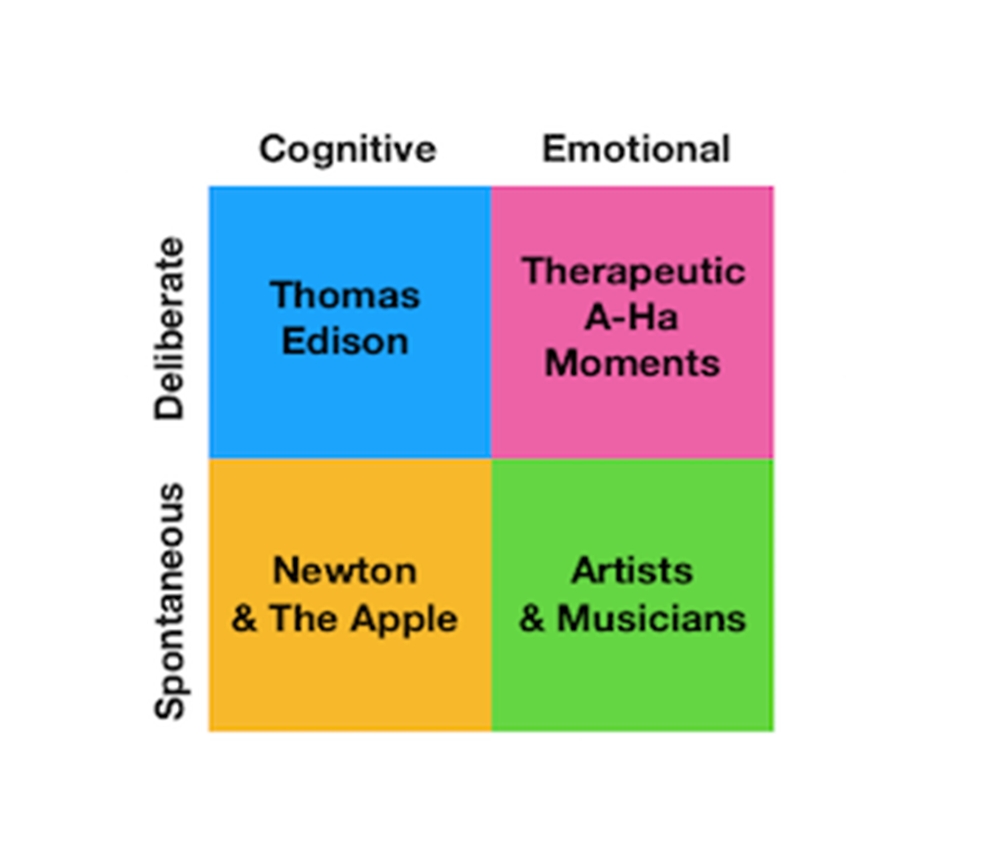
Unit 1
Examples of different types of creativity
Deliberate and cognitive creativity - requires a high level of knowledge and a lot of time (e.g., the inventor Thomas Edison)
Deliberate and emotional creativity - requires quiet time (e.g., “a-ha” moments)
(3) Spontaneous and cognitive creativity - requires an existing body of
knowledge and stopping work on the problem and stepping away (e.g.,
the story of Isaac Newton discovering gravity)
(4) Spontaneous and emotional creativity - does not require specific
knowledge but often requires skill - written, artistic, musical (e.g.
artists and musicians)
With the support of the Erasmus+ programme of the European Union. This document and its contents reflects the views only of the authors, and the Commission cannot be held responsible for any use which may be made of the information contained therein.

Slide 15
Unit 2
Overcoming personal barriers to creativity
In the ideal R&D organization, appropriate ideas are welcomed, assessed, and implemented.
Self-respect and mutual respect flourish, and employees frequently increase their self-awareness, self-acceptance, and self-esteem.
Under these conditions, individuals and organization can reach their potential.
Creative individuals and organization will establish the structure where:
  Group operates to capacity;
  People tell the truth;
  Each person takes responsibility for personal behavior and feelings.
With the support of the Erasmus+ programme of the European Union. This document and its contents reflects the views only of the authors, and the Commission cannot be held responsible for any use which may be made of the information contained therein.

Slide 16
Unit 2
Overcoming personal barriers to creativity
Individual can maximize creative potential by overcoming psychological blocks that can arise at each stage of creative process.
Very often, these blocks stem from our uncertainty that distort creative and intellectual abilities since they lead us to try to avoid, respectively, being ignored, humiliated, and rejected.
To remove obstacles to creativity and logical thinking, obstacles at each stage of the creative process have to be identified (Schutz, 1995).
With the support of the Erasmus+ programme of the European Union. This document and its contents reflects the views only of the authors, and the Commission cannot be held responsible for any use which may be made of the information contained therein.

Slide 17
Unit 2
Overcoming personal barriers to creativity
  Stage 1: Experience
  You have to acquire a repertory of experiences before discovering creative solution. Blocks to obtaining experiences are:
    Fear of not learning;
    Fear of violating standards.
  Stage 2: Association
  You should be able to associate experiences into a useful product. The blocks to making associations are:
    Overvaluing rationality;
    Fear of self-awareness.
With the support of the Erasmus+ programme of the European Union. This document and its contents reflects the views only of the authors, and the Commission cannot be held responsible for any use which may be made of the information contained therein.

Slide 18
Unit 2
Overcoming personal barriers to creativity
  Stage 3: Expression
  You should be able to express his/her idea. The obstacles to expression are:
    • Fear of embarrassment;
    • Fear of assertion.
  Stage 4: Evaluation
  You must be able to distinguish the creative from be, the productive from the irrelevant. Obstacles to evaluation are:
    • Fear of humiliation;
    • Fear of rejection.
With the support of the Erasmus+ programme of the European Union. This document and its contents reflects the views only of the authors, and the Commission cannot be held responsible for any use which may be made of the information contained therein.

Slide 19
Unit 2
Overcoming personal barriers to creativity
Stage 5: Perseverance
The concept of continuous improvement says any process or product should be endlessly revised and improved. Perseverance blocks include:
    • Fear of failure;
    • Lack of rewards.
With the support of the Erasmus+ programme of the European Union. This document and its contents reflects the views only of the authors, and the Commission cannot be held responsible for any use which may be made of the information contained therein.

Slide 20
Unit 2
Overcoming personal barriers to creativity
“The key to dissolving blocks to creativity lies in the kind of self-esteem that thrives in an open, truthful organization, where everyone can express their concerns openly and their humanity will be accepted. When we can focus on problems rather than defenses, and when we all feel safe to acknowledge our fears, the organization becomes a community that helps each person to identify and remove these blocks— and experience soaring creativity.”(Schutz, 1995).
With the support of the Erasmus+ programme of the European Union. This document and its contents reflects the views only of the authors, and the Commission cannot be held responsible for any use which may be made of the information contained therein.

Slide 21
Unit 2
Team creativity
Team creativity can be defined as the joint novelty and usefulness of a final idea developed by a group of people.
Four ways to support the creative spark and the exchange of ideas at work (https://blog.flock.com/4-proven-ways-to-encourage-team-creativity):
  Promote workplace flexibility
  Introduce a collaboration app
  Adopt design thinking
  Recognize creative success
With the support of the Erasmus+ programme of the European Union. This document and its contents reflects the views only of the authors, and the Commission cannot be held responsible for any use which may be made of the information contained therein.

Slide 22
Unit 2
Creativity in the workplace
Creativity in the workplace can be defined as taking risks- taking you and your team out of your comfort zone, and into the unknown. Injecting creativity into your workplace is one of the most important steps to success.
Injecting creativity into your workplace is one of the most important steps to success. If you can find a way to apply it to your workplace, you will unlock new, fresh and innovative ideas (https://engageinlearning.com/blog/why-is-creativity-important-in-the-workplace/).
With the support of the Erasmus+ programme of the European Union. This document and its contents reflects the views only of the authors, and the Commission cannot be held responsible for any use which may be made of the information contained therein.

Slide 23
Unit 2
Creativity in the workplace
Fundamentals for creative thinking are:
Analysis - analyzing the current order of things provides the foundation for creative thinking.
Open-minded - be open to making mistakes and hitting a few dead ends before making a break through.
Organization - ability to structure a thought and turn it into a plan with a process, goal and deadline is essential.
Communication – great ideas are only useful if they can be communicated to others (written, verbal and listening skills).
Training – that will encourage and develop creative thinking and problem solving skills.
With the support of the Erasmus+ programme of the European Union. This document and its contents reflects the views only of the authors, and the Commission cannot be held responsible for any use which may be made of the information contained therein.

Slide 24
Unit 2
Creativity in the workplace
The benefits of fostering creativity in the workplace include
  Creativity Builds Better Teamwork
  Creativity Improves the Ability to Attract and Retain Employees
  Creativity Increases Problem-Solving
With the support of the Erasmus+ programme of the European Union. This document and its contents reflects the views only of the authors, and the Commission cannot be held responsible for any use which may be made of the information contained therein.

Slide 25
Unit 2
Creativity Techniques
Creativity training programmes are most commonly focused on
  idea generation
  cognitive processing activities for developing creative problem-solving skills.
  Creativity techniques are the mean to develop these skills
Creativity techniques
  „Specific sessions to facilitate the creative process by providing strategies and heuristics to develop new ideas” (e.g., Herrmann & Felfe, 2014; Meinel & Voigt, 2017, ).
  Creativity Techniques are tools to “awaken and strengthen the creative potential of individuals” (Leopoldino et al., 2016, p. 95).
  Applied in different stages of the innovation process => particularly in the idea generation stage (Meinel & Voigt, 2017; Smith, 1998).
With the support of the Erasmus+ programme of the European Union. This document and its contents reflects the views only of the authors, and the Commission cannot be held responsible for any use which may be made of the information contained therein.

Slide 26
Unit 2
Creativity Techniques (Geschka, 1983 and Wöhler, J., & Reinhardt, R., 2021)
Two dimensions:
  Idea generation by:
    stimulating intuition
    using a systematic problem-solving approach.
  Idea triggering mechanism:
    Ideas can either be a result of variation and development of existing ideas
    Ideas can be triggered by a confrontation with events, objects or thoughts that are independent of the problem at hand.
From these two dimensions => Four categories of creativity techniques
  intuitive association (IA),
  intuitive confrontation (IC),
  systematic variation (SV)
  systematic confrontation (SC).
With the support of the Erasmus+ programme of the European Union. This document and its contents reflects the views only of the authors, and the Commission cannot be held responsible for any use which may be made of the information contained therein.

Slide 27
Unit 2
Creativity Techniques (Wöhler, J., & Reinhardt, R., 2021, p. 146).
 |  | Idea Triggering Mechanism
 |  | Variation | Confrontation
 |  | Methods of Intuitive Association (IA) | Methods of Intuitive Confrontation (IC)
 | Stimulation of Intuition | Brainstorming Brainwriting Speed-Dating | Stimulating Word Analysis Semantic Intuition Provocation
 |  | Methods of Systematic Variation (SV) | Methods of Systematic Confrontation (SC).
 | Systematic-Analytical Concept | Morphological Tableau Programming | Six Thinking Hats TRIZ TILMAG
With the support of the Erasmus+ programme of the European Union. This document and its contents reflects the views only of the authors, and the Commission cannot be held responsible for any use which may be made of the information contained therein.

Slide 28

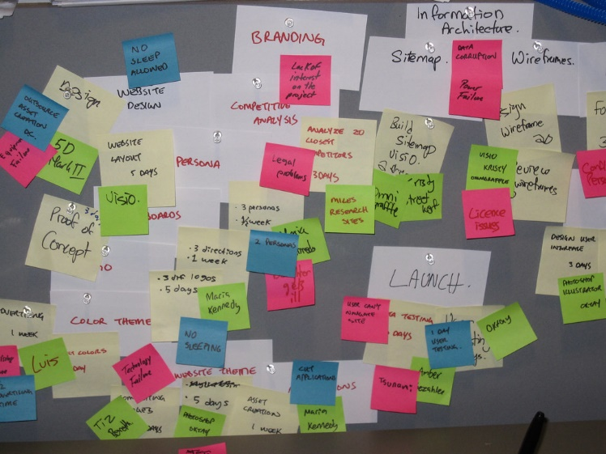
Unit 2
Creativity Techniques: Brainstorming and Brainwriting
Brainstorming
all group sessions aiming to gather a number of ideas addressed to solve a certain issue.
environment in which individuals collaborate => entire group makes decisions, not just an individual
No restrictions of creativity for suggestions
Result: a list of ideas freely contributed by all group members.
Brainstorming is both a method of study and learning, and a method of scientific inquiry and creativity (REFERENCA).
With the support of the Erasmus+ programme of the European Union. This document and its contents reflects the views only of the authors, and the Commission cannot be held responsible for any use which may be made of the information contained therein.

Slide 29
Unit 2
Creativity Techniques: Brainstorming and Brainwriting
Brain-writing
relatively less-known technique
It can further develop the ideas generated by brainstorming session.
Liticanu et al. (2015) suggest some advantages over brainstorming:
Writing, instead just saying ideas makes people to think idea trough and articulate more clearly;
It can help more shy participants to express
it is advantageous if the group tends to "socialize" too much;
compared to brainstorming, brain-writing tends to result in somewhat fewer, but more fully developed, ideas (Roco, 2004)
With the support of the Erasmus+ programme of the European Union. This document and its contents reflects the views only of the authors, and the Commission cannot be held responsible for any use which may be made of the information contained therein.

Slide 30

Unit 2
Creativity Techniques: Six Thinking Hats
The six thinking hats metaphor
Six different cognitive approaches to critical thinking
Six hats are coloured differently and each one represents a different approach to the problem.
The colours are:
Black – Difficulties, Negative aspects, Caution and criticalness
Blue – Process, Organisational thinking: recap, next steps…
Green – Creativity, new ideas, alternatives
Red – Emotions, Intuiotion, Instinct and hunches
White – Facts, data, rationality
Yellow – Benefits, Positive aspects, Brightness and optimism
With the support of the Erasmus+ programme of the European Union. This document and its contents reflects the views only of the authors, and the Commission cannot be held responsible for any use which may be made of the information contained therein.

Slide 31
Unit 3
Design Thinking
Widely accepted definition of design thinking is still missing.
User Focus,
Problem Framing,
Diversity,
Experimentation
Visualization
Framework (Carlgren et al., 2016):
Design thinking is a process regularly used by designers,
Failure and difficulties are not seen as a threat,
Rapidly spreading among organisations as a mean to foster innovation through creative problem-solving process.
Entrepreneurs can use design thinking, i.e. reflexion, alternatives, visualisation, creative-problem solving to identify unique venture opportunities.
It is a way to further learning
Failure encourage individuals to produce innovative ideas and solutions.
With the support of the Erasmus+ programme of the European Union. This document and its contents reflects the views only of the authors, and the Commission cannot be held responsible for any use which may be made of the information contained therein.

Slide 32
Main practices of design thinking (Dell’Era et al., 2018, p.330)
Theme | Practices
Human-centered design | Involving users Empathising with humans
Problem Framing | Framing and reframing Abductive reasoning Embracing ambiguity
Diversity | Integrative thinking Holistic thinking Interdisciplinary collaboration
Experimentation | Learning by doing Failing often and soon Diverging/Converging
Visualisation | Making ideas and insights visual and tangible Representing abstract concepts

Slide 33
Unit 3
Dell’Era et al. (2018, p. 329) list four kinds of design thinking:
Creative Problem Solving: Solving wicked problems by adopting both analytical and intuitive thinking
Sprint Execution: Delivering and testing viable products to learn from customers and improve the solution
Creative Confidence: Engaging people to make them more confident with creative processes
Innovation of Meaning: Envisioning new directions that aim at proposing meaningful experiences to people
With the support of the Erasmus+ programme of the European Union. This document and its contents reflects the views only of the authors, and the Commission cannot be held responsible for any use which may be made of the information contained therein.

Slide 34
Summing Up
Creativity
Team creativity
"the ability to produce work that is both novel and appropriate"
„the joint novelty and usefulness of a final idea developed by a group of people”
The 4P model of creativity
Creativity Techniques
Person, Processes, Products and Press
„Tools to awaken one’s creativity”
Brainstorming, Brainwriting, Six Thinking Hats….
Barriers to creativity
Design Thinking
„Individual can maximize creative potential by overcoming psychological blocks that can arise at each stage of creative process.”
Process usually used by designers but recently inspires entrepreneurs in their decision-making.
reflexion, alternatives, visualisation, empathy, creative-problem solving
With the support of the Erasmus+ programme of the European Union. This document and its contents reflects the views only of the authors, and the Commission cannot be held responsible for any use which may be made of the information contained therein.

Slide 35
Self-assessment test
1. Which of the following is not one of the components of creativity?
2. Which type of creativity requires a great amount of knowledge about a particular subject and a lot of time?
3. According to the Investment Theory of Creativity, creativity is in large part:
4. Individual can maximize creative potential
5. Creativity in the workplace can be defined as:
A venturesome personality
Imaginative thinking skills
A creative environment
Visualization
Intrinsic motivation
by overcoming psychological blocks that can arise at each stage of creative process
by developing creative thinking and problem solving skills.
By evaluating the obstacles
By rewarding employees
taking risks
evaluating opportunities
recognizing creative success
fear of humiliation
Deliberate and cognitive creativity
Deliberate and emotional creativity
Spontaneous and cognitive creativity
Spontaneous and emotional creativity
A curiosity
Self-expression
A decision
Tolerance
Perseverance
With the support of the Erasmus+ programme of the European Union. This document and its contents reflects the views only of the authors, and the Commission cannot be held responsible for any use which may be made of the information contained therein.

Slide 36
Self-assessment test
Creativity techniques are most commonly focused on:
Brainstorming and brainwriting are:
During six hats thinking process, Pero said: “Sail is falling, product will lose its market, firm will bankrupt”. He is wearing:
What is the first step in the process of Design Thinking
Which kind of design thinking engage people to make them more confident with creative processes
profits
taking risk
idea generation
reducing costs and revenues
processes in which one individual makes a list of ideas
processes that can create a competitive environment to promote new and creative ideas
processes in which team members do not mater
all of the above
none of the above
Visualise
Experiment
Empathise
None of the above
yellow hat
blue hat
green hat
black hat
Creative problem solving
Sprint execution
Creative confidence
Innovation of Meaning
With the support of the Erasmus+ programme of the European Union. This document and its contents reflects the views only of the authors, and the Commission cannot be held responsible for any use which may be made of the information contained therein.

Slide 37
Thank you!

