Slide 1


Enhance Soft Skills to Nurture
Competitiveness and Employability
Teamwork through ICT tools
PARTNER: Internet Web Solutions

Slide 2

OBJECTIVES AND GOALS
At the end of this module you will be able to:
To learn some of the most important ICT tools in the business environment, as well as their benefits and characteristics.
Encourage collaboration and teamwork through ICT tools.
Solve difficulties related to communication due to teleworking.
To ensure a good atmosphere in the business team through effective communication.

Slide 3

INDEX
Course 2
Unit 1
Unit 1.1
Unit 2
Unit 2.1
Teamwork using ICT tools
ICT tools and teamwork
ICT tools for teamwork, collaboration and coordination with others
Teamwork and coordination issues using ICT tools and tips for improving it in a creative way.
Tips for a good coordination and communication

Slide 4



Teamwork using ICT tools
Unit 1
Unit 1: ICT tools and teamwork
ICT tools have proven to be an efficient ally in many sectors: from business management to international communication or personal daily life. Thus, using them to enhance teamwork and communication is a good resource.
Most companies today have turned to teamwork and collaboration as a method of working. This brings countless advantages, among them:
With the support of the Erasmus+ programme of the European Union. This document and its contents reflects the views only of the authors, and the Commission cannot be held responsible for any use which may be made of the information contained therein.

Slide 5

Teamwork using ICT tools
Unit 1
The talents and skills of each worker are recognised and utilised.
A greater number and diversity of ideas proposed, which translates into more opportunities.
The level of team bonding and complicity increases, thus fostering a good working environment, trust and effectiveness.
With the support of the Erasmus+ programme of the European Union. This document and its contents reflects the views only of the authors, and the Commission cannot be held responsible for any use which may be made of the information contained therein.

Slide 6

Teamwork using ICT tools
Unit 1
The collaborative nature means that all members work together, so that the individual weaknesses of each employee can be dynamically improved.
Unity is strength: By bringing together all the strengths, skills and knowledge of each person, we will achieve a team with greater potential than all these parts separately.
This is why collaborative work is one of the best options to increase the effectiveness and good atmosphere in the team.
With the support of the Erasmus+ programme of the European Union. This document and its contents reflects the views only of the authors, and the Commission cannot be held responsible for any use which may be made of the information contained therein.

Slide 7

Teamwork using ICT tools
Unit 1
1.1 ICT tools for teamwork, collaboration and coordination with others
Technological development in recent years has been so significant that it is now difficult to conceive of a company and its activity without resources such as platforms, systems and applications to guarantee its services. Whether they are SMEs or large companies, ICT resources are very useful in terms of work distribution and collaboration.
The world of ICT is very large and diverse, and it is impossible to classify them all in one list, but here are a few to help foster teamwork.
With the support of the Erasmus+ programme of the European Union. This document and its contents reflects the views only of the authors, and the Commission cannot be held responsible for any use which may be made of the information contained therein.

Slide 8

Teamwork using ICT tools
Unit 1
Project management tools:
Project management tools are an essential part of the team management process. Thanks to them, we can ensure the good distribution and allocation of tasks between colleagues. Among the best-known project management ICTs, we can find the following:
With the support of the Erasmus+ programme of the European Union. This document and its contents reflects the views only of the authors, and the Commission cannot be held responsible for any use which may be made of the information contained therein.

Slide 9

Teamwork using ICT tools
Unit 1
Asana: Asana is a web-based platform that can help plan and organise everything related to teamwork. In addition, it can also act as a collaboration tool. It coordinates tasks, shares, plans, organises, and tracks the progress of the project each member is working on.
With the support of the Erasmus+ programme of the European Union. This document and its contents reflects the views only of the authors, and the Commission cannot be held responsible for any use which may be made of the information contained therein.

Slide 10

Teamwork using ICT tools
Unit 1
Project.co: This project management platform allows users to work on more than one task at a time. You can share files, create lists, calendars and schedules, Kanban boards, invoices... This makes task tracking simple and dynamic.
With the support of the Erasmus+ programme of the European Union. This document and its contents reflects the views only of the authors, and the Commission cannot be held responsible for any use which may be made of the information contained therein.

Slide 11

Teamwork using ICT tools
Unit 1
nTask: This free smart platform is designed for teams, allowing to schedule meetings, exchange files, plan projects and many more options. Its project management software provides all the necessary tools.
With the support of the Erasmus+ programme of the European Union. This document and its contents reflects the views only of the authors, and the Commission cannot be held responsible for any use which may be made of the information contained therein.

Slide 12

Teamwork using ICT tools
Unit 1
Teamwork: This online cloud-based solution provides functionalities to manage various aspects of a business. Its services include task lists, time and deadline management, file and message sharing, among others.
With the support of the Erasmus+ programme of the European Union. This document and its contents reflects the views only of the authors, and the Commission cannot be held responsible for any use which may be made of the information contained therein.

Slide 13

Teamwork using ICT tools
Unit 1
- Communication and collaboration tools:
Communication is key in any work environment. With the current Covid-19 situation, many companies have been forced to resort to teleworking, so communication has become complicated and artificial. For this purpose, we have platforms available to improve the exchange of information, such as:
With the support of the Erasmus+ programme of the European Union. This document and its contents reflects the views only of the authors, and the Commission cannot be held responsible for any use which may be made of the information contained therein.

Slide 14


Teamwork using ICT tools
Unit 1
Skype: The videoconferencing platform par excellence. Its services include online calls (audio or video), chats, conferences of up to 50 people, scheduling meetings, among other tasks.
Zoom: This video conferencing service has become one of the leading platforms in the field. This service is suitable for teams of all natures. It interacts in a virtual workspace, makes video or audio calls, with live chats and records sessions to ensure nothing is missed.
With the support of the Erasmus+ programme of the European Union. This document and its contents reflects the views only of the authors, and the Commission cannot be held responsible for any use which may be made of the information contained therein.

Slide 15

Teamwork using ICT tools
Unit 1
Microsoft Teams: This workspace has options for meetings by chat, video or calls. It also allows you to store documents, photos, videos and chat history. Customise and configure your workspace with apps to organise your work.
With the support of the Erasmus+ programme of the European Union. This document and its contents reflects the views only of the authors, and the Commission cannot be held responsible for any use which may be made of the information contained therein.

Slide 16

Teamwork using ICT tools
Unit 1
- Document management tools:
A document repository is a space where documents are stored, managed and organised so that members of the whole team can access them when needed. It is managed by members with administration rights. In this way, we can streamline and unify the whole process of document consultation and management. Once again, there are various ICT tools that can help us:
With the support of the Erasmus+ programme of the European Union. This document and its contents reflects the views only of the authors, and the Commission cannot be held responsible for any use which may be made of the information contained therein.

Slide 17


Teamwork using ICT tools
Unit 1
DocuWare: This platform allows you to capture, process and use company information. Its software automatizes a large part of the querying and organisation of documents in a centralised and secure system.
M-Files: This information management option features ease of use, versatility and functionality suitable for a wide variety of industries. You can access content from multiple data repositories without the need for migration. You can deploy it in the cloud, on-premises or in a hybrid way.
With the support of the Erasmus+ programme of the European Union. This document and its contents reflects the views only of the authors, and the Commission cannot be held responsible for any use which may be made of the information contained therein.

Slide 18

Teamwork using ICT tools
Unit 1
LogicalDOC: Control your document management. Create, co-produce and coordinate any amount of documents, fostering collaboration and productivity. Its versatile software allows it to adapt to different business models.
With the support of the Erasmus+ programme of the European Union. This document and its contents reflects the views only of the authors, and the Commission cannot be held responsible for any use which may be made of the information contained therein.

Slide 19

Teamwork using ICT tools
Unit 2
Unit 2: Teamwork and coordination issues using ICT tools and tips for improving it in a creative way.
2.1. Tips for a good coordination and communication
Team coordination and communication is a complex and difficult issue to manage. All members must do their part to ensure the success of the work. This is why a number of aspects must be taken into account in order to achieve good effectiveness and a good atmosphere. Here are some tips on how to achieve these results:
With the support of the Erasmus+ programme of the European Union. This document and its contents reflects the views only of the authors, and the Commission cannot be held responsible for any use which may be made of the information contained therein.

Slide 20
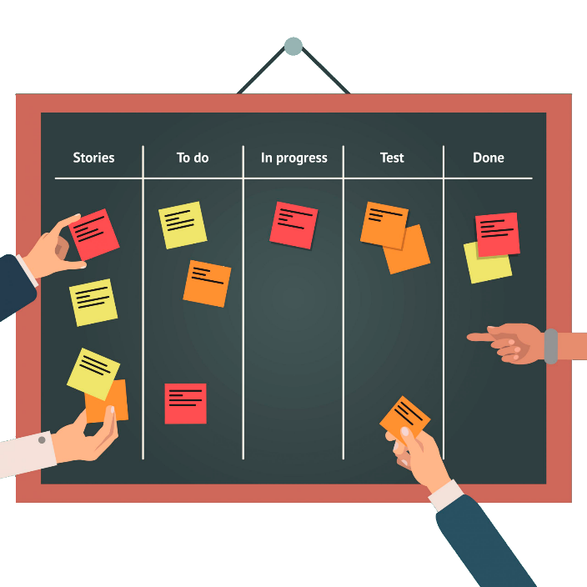
Teamwork using ICT tools
Unit 2
Ensure a correct distribution of work. The platforms described above are used to allocate the various tasks among the entire team. Some of them use the Kanban method, which is a tool to visualise the workflow. It consists of boards divided into rows and columns: the first ones for the project or activity and the second ones for its degree of development (to be done, pending revision, blocked, etc). These digital Kanban tools allow an organisation of work that is easy to visualise and distribute, making them a potential ally for greater effectiveness..
With the support of the Erasmus+ programme of the European Union. This document and its contents reflects the views only of the authors, and the Commission cannot be held responsible for any use which may be made of the information contained therein.

Slide 21

Teamwork using ICT tools
Unit 2
When writing emails, be clear and concise. Remember to greet, identify yourself and say goodbye properly. In addition, using an appropriate subject heading will allow for better classification of these messages.
With the support of the Erasmus+ programme of the European Union. This document and its contents reflects the views only of the authors, and the Commission cannot be held responsible for any use which may be made of the information contained therein.

Slide 22

Teamwork using ICT tools
Unit 2
Hold regular meetings. This will allow us to be aware of the general situation of the company and of each colleague, allowing us to improve the distribution of tasks and a fluid and dynamic communication.
Do not hesitate to ask for and offer help if needed. As mentioned above, every colleague has strengths and weaknesses, which can be used and improved respectively through teamwork. Remember: union makes strength.
With the support of the Erasmus+ programme of the European Union. This document and its contents reflects the views only of the authors, and the Commission cannot be held responsible for any use which may be made of the information contained therein.

Slide 23

Teamwork using ICT tools
Unit 2
Motivation is key. Congratulate colleagues who have been successful in their work; or offer help if, on the other hand, they are having difficulties or problems and you know how to help, don't hesitate to offer your hand. Joint problem solving can foster team bonding and effectiveness.
With the support of the Erasmus+ programme of the European Union. This document and its contents reflects the views only of the authors, and the Commission cannot be held responsible for any use which may be made of the information contained therein.

Slide 24

Teamwork using ICT tools
Unit 2
Team activities outside the company are highly recommended. This will not only create a more comfortable and enjoyable atmosphere, but will also strengthen bonds and create a more united team. For example, once a month you could do some recreational activities, such as playing a sport, visiting a place or having lunch together.
With the support of the Erasmus+ programme of the European Union. This document and its contents reflects the views only of the authors, and the Commission cannot be held responsible for any use which may be made of the information contained therein.

Slide 25
Thank you!

