Slide 1
Enhance Soft Skills to Nurture
Competitiveness and Employability
Effective communication in the digital environment
PARTNER: Internet Web Solutions

Slide 2
OBJECTIVES AND GOALS
At the end of this module you will be able to:
Acquire basic knowledge about digital communication and its current context.
Identify the main communication problems in the digital era.
Enhance communication skills in the digital environment. From a management perspective, towards an employee/work team perspective. A practical guide to boost effective communication in the work environment.

Slide 3
INDEX
Course 1
Unit 1
Unit 2
Unit 3
Effective communication in the digital environment.
Communication in the digital environment. The new communication.
Main communication problems in digital era.
Boosting your communication skills in the digital environment. A practical guide.

Slide 4
Effective communication in the digital environment
Unit 1
Communication in the digital environment. The new communication.
The spread in the use of the Internet over the last few decades has brought about profound changes in the way we communicate.
Most of us may know by now that digital communication is any type of communication that is based on the use of technology. There are many channels and forms of digital communication. In the workplace, which is what we will focus on in this module, it can range from sending an email, having a chat conversation with your work team, or having an online professional meeting through some platform, among others.
But, do we know how to have effective digital communication in the workplace and how to get the most out of it?
With the support of the Erasmus+ programme of the European Union. This document and its contents reflects the views only of the authors, and the Commission cannot be held responsible for any use which may be made of the information contained therein.

Slide 5
Effective communication in the digital environment
Unit 1
In this module we will focus on how to improve digital communication and thus coordination with others, by developing the necessary skills that will help drive effective digital communication in the work environment.
Currently, after the COVID-19 crisis, the digitalization processes of companies have accelerated, which has led to the establishment of new remote working methodologies, encompassed in the new term called Smart working, in which work teams become virtual.
With the support of the Erasmus+ programme of the European Union. This document and its contents reflects the views only of the authors, and the Commission cannot be held responsible for any use which may be made of the information contained therein.

Slide 6
Effective communication in the digital environment
Unit 1
Therefore, it should be noted that this type of digital communication is nowadays the new norm, in which in addition to the knowledge of certain skills and digital tools, we must learn the codes of conduct of communication in the current digital environment, and work on our soft communication skills, to achieve effective communication, which is basic for teamwork and coordination with others, the professional development of the individual, as well as to have an attractive, productive and enjoyable work experience, and in turn adapt to the new circumstances and labour challenges in which we live.
To achieve the above objectives, it is valuable to know that digital communication has inherent characteristics, advantages and disadvantages compared to the face-to-face communication to which we have long been accustomed. Digital communication is faster, interactive, decentralized, more participatory, less hierarchical. Above all, it allows us to interact immediately, eliminating the physical barriers that could condition us before. One of its particular characteristics is that it is not usually accompanied by the non-verbal language that accompanies traditional communication, which poses new paradigms.
According to these characteristics, let's see in the following unit, what are the most common problems that can arise through digital communication in the workplace.
With the support of the Erasmus+ programme of the European Union. This document and its contents reflects the views only of the authors, and the Commission cannot be held responsible for any use which may be made of the information contained therein.

Slide 7
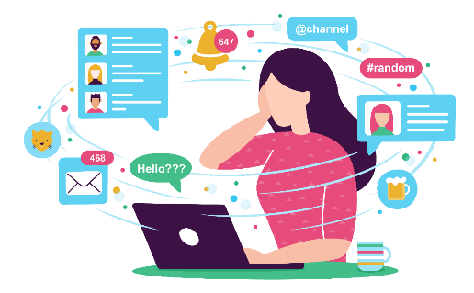
Effective communication in the digital environment
Unit 2
Main communication problems in digital era
Communication barriers are those that prevent a free, clear and effective transmission of information or message. Let's see in the digital work environment, what are the most common problems that we can find in our team.
Cooling of interpersonal relationships in the virtual work team: The lack of contact in virtual work or digital communication can lead to feelings of isolation, loneliness and cooling of team relationships, which can have a negative impact on the individual, affecting their well-being, productivity and the work environment itself.
Problems in the interpretation of the message: The digital message is easy to misinterpret. Through this medium, the non-verbal signals of communication, such as tone of voice, emphasis, hand gestures, facial tone, body position, etc., which usually accompany the interpretation of the information, are not seen. This can lead to a misinterpretation of messages or information, in which we end up giving a subjective or personal interpretation of the receiver (based on his emotional state. We hear and see what we emotionally tune in), losing the initial effectiveness or objectivity of the message.
With the support of the Erasmus+ programme of the European Union. This document and its contents reflects the views only of the authors, and the Commission cannot be held responsible for any use which may be made of the information contained therein.

Slide 8
Effective communication in the digital environment
Unit 2
It creates a false security / coldness: For many people, the physical distance of digital communication creates a sense of "false security", which face-to-face communication does not provide, and makes them feel safer, as if digital communication were not "real", and they can manifest a more "aggressive" behaviour or a certain lack of caution in communication, shielded by the medium and the distance. It is easier for them to express themselves through this type of medium than when we have to look someone in the eye and share our feelings or opinions.
The immediacy / instantaneousness of the message: The perspective of instant communication creates an additional pressure to compensate presentiality, which can often lead to write quickly, answer quickly, which can transform what should be a thoughtful response, in a reaction, which can lead in turn to recklessness, more difficult to remedy by the intrinsic characteristics of the digital medium.
With the support of the Erasmus+ programme of the European Union. This document and its contents reflects the views only of the authors, and the Commission cannot be held responsible for any use which may be made of the information contained therein.

Slide 9
Effective communication in the digital environment
Unit 2
The persistence of the message or digital fingerprint: The digital medium, in addition to having multiple advantages, has the particularity of remaining in the electronic medium, this means that the messages we send, or the conversations we have, etc., remain reflected in the medium and will remain in the digital support, unlike traditional communication, which we could say is more “ephemeral".
Use of vocabulary with certain meanings: Languages, technical terms, anglicisms, colloquial language, symbols with more than one meaning, poor expression, etc., which the receiver, for different reasons, may interpret them differently or not understand them at all, which leads to a distortion of the message we receive or that we intended to convey.
With the support of the Erasmus+ programme of the European Union. This document and its contents reflects the views only of the authors, and the Commission cannot be held responsible for any use which may be made of the information contained therein.

Slide 10
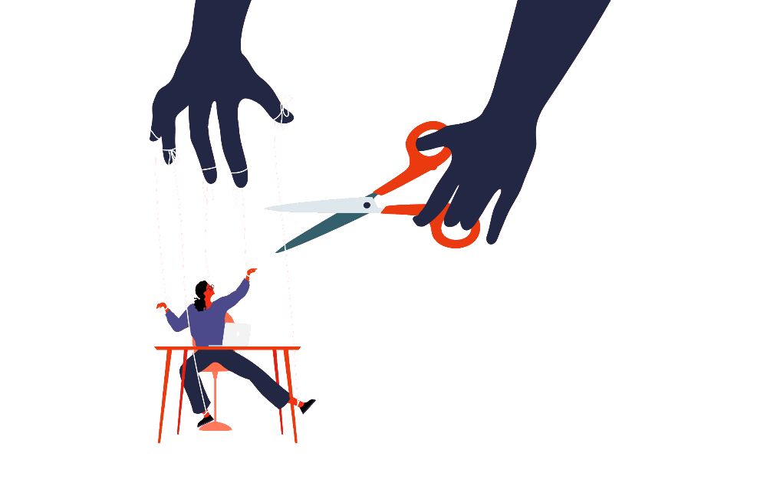
Effective communication in the digital environment
Unit 2
Lack of clarity in the instructions and objectives: The clarity of information and guidelines in the digital environment is of utmost importance. This is what will enable the team to follow them properly and achieve the proposed objectives.
No knowledge of the work being done by others: Many times, we do not have the appropriate tools for this purpose. This feeling can also be due to the lack of physical presence to which we are so used to, and the coexistence in a new environment in which the presence is virtual.
Lack of responsibility and autonomy: Autonomous time management and self-sufficiency are essential for performance in today's digital work environments, a factor that in turn influences coordination with the rest of the team.
With the support of the Erasmus+ programme of the European Union. This document and its contents reflects the views only of the authors, and the Commission cannot be held responsible for any use which may be made of the information contained therein.

Slide 11
Effective communication in the digital environment
Unit 2
Misunderstandings within multicultural teams: One factor to take into account is the message in multicultural digital environments, in which not everyone has the same interpretative codes or communicative behaviour. Hence the need to work on the effective digital message, assertive, and adapted to the medium and the environment.
Lack of feedback: Feedback in the digital work environment helps the fluidity and synergy of communication, in this medium it is essential to maintain an exchange of information that keeps us always up to date, and in which it is known that our information is being received, read and understood.
Lack of a generalized digital language established: Digital language is very recent compared to the history of traditional language that we all know and have learned. For this new digital language, there is still no common formal basis established that we can all follow and interpret according to a common standard, which can lead to different interpretations.
With the support of the Erasmus+ programme of the European Union. This document and its contents reflects the views only of the authors, and the Commission cannot be held responsible for any use which may be made of the information contained therein.

Slide 12
Effective communication in the digital environment
Unit 3
Boosting your communication skills in the digital environment. A practical guide.
As we have seen above, virtual work teams are exposed to a number of difficulties that often slow down the work and prevent proper progress. To prevent these inconveniences from affecting the work team, its projects and objectives, it is important to design strategies in order to know how to overcome them.
Assertive communication in the digital workplace is of vital importance for the achievement of professional objectives both individually and as part of a team, and in all areas of business communication, from management to communication between employees or with customers.
With the support of the Erasmus+ programme of the European Union. This document and its contents reflects the views only of the authors, and the Commission cannot be held responsible for any use which may be made of the information contained therein.

Slide 13
Effective communication in the digital environment
Unit 3
Assertive communication is effective communication, which through coherence, respect for oneself and others, understanding, active listening, honesty and clarity, gets the message across in the most effective and practical way possible. This type of skill, indispensable in the work environment, has an impact on improving professional performance, as well as on the personal well-being of the individual.
With the support of the Erasmus+ programme of the European Union. This document and its contents reflects the views only of the authors, and the Commission cannot be held responsible for any use which may be made of the information contained therein.

Slide 14
Effective communication in the digital environment
Unit 3
Let's see the basic steps for an assertive communication:
• Active listening, and encouraging participation in a bidirectional way.
• Identify the barriers that hinder communication both individually and in the work team.
• Breaking down the identified barriers to improve communication.
• Create individual and group strategies to prevent the identified communication problems.
With the support of the Erasmus+ programme of the European Union. This document and its contents reflects the views only of the authors, and the Commission cannot be held responsible for any use which may be made of the information contained therein.

Slide 15
Effective communication in the digital environment
Unit 3
Knowing the basics of assertive communication, let's now look at some tips to improve our communication skills, in the Practical Guide to Improve Communication in the Digital Environment:
- Management perspective:
• Humanize the virtual environment.
• Open reliable communication channels in the virtual environment and teach your team how to use these channels for their own benefit.
• Strengthen motivation and trust in the work team.
• Activates synergy among team members.
• Strengthens autonomy and empowerment in the team.
With the support of the Erasmus+ programme of the European Union. This document and its contents reflects the views only of the authors, and the Commission cannot be held responsible for any use which may be made of the information contained therein.

Slide 16
Effective communication in the digital environment
Unit 3
• Educates and trains the virtual team so that everyone knows their duties and responsibilities, enabling them to improve the quality of their work.
• Use reliable and appropriate tools for your work environment and your team. This will help to maintain a greater sense of community, and to carry out increasingly efficient processes.
• Perform a feedback process to accompany and enrich everyone's work.
• Establish and set meeting schedules and their duration in advance, so that there are no communication setbacks among the team and everyone is prepared and available for this purpose.
• Implement clear working conditions and modifications designed only for your virtual team.
With the support of the Erasmus+ programme of the European Union. This document and its contents reflects the views only of the authors, and the Commission cannot be held responsible for any use which may be made of the information contained therein.

Slide 17
Effective communication in the digital environment
Unit 3
• Encourage work through virtual events and meetings.
• Organize activities based on common interests, to boost motivation and communication within the team.
• Keep attention spans in mind. The attention span in communication is limited, and more so in the digital environment. That's why in this environment, being concise is key.
• Virtual meetings, just like physical meetings, need to be quick, effective, concise and operational.
• If you are the leader of a meeting, you must make sure you are a good mediator, and give the floor to all team members, so that no one feels excluded.
With the support of the Erasmus+ programme of the European Union. This document and its contents reflects the views only of the authors, and the Commission cannot be held responsible for any use which may be made of the information contained therein.

Slide 18
Effective communication in the digital environment
Unit 3
- Employee/work team perspective:
• Count on the most effective and appropriate digital tools for communication in your work environment.
Be curious, find out and train yourself in the tools you do not know how to use.
With the support of the Erasmus+ programme of the European Union. This document and its contents reflects the views only of the authors, and the Commission cannot be held responsible for any use which may be made of the information contained therein.

Slide 19
Effective communication in the digital environment
Unit 3
• Choose the right channel for each occasion. This will improve your digital interactions.
Sometimes you will consider using a channel such as chat for more instant messages, email for more formal communications, and sometimes online video support for a more detailed conversation, supported by the facial expressions and body language provided by the image.
Avoid using e-mail or chat in conflict situations, and opt for means such as telephone or videoconferencing that convey closeness. Also, try not to copy people unnecessarily, or use capital letters if it is not to give a positive connotation to the message.
With the support of the Erasmus+ programme of the European Union. This document and its contents reflects the views only of the authors, and the Commission cannot be held responsible for any use which may be made of the information contained therein.

Slide 20
Effective communication in the digital environment
Unit 3
• Construct your message in a clear and concise manner, do not take anything for granted.
Avoid ambiguous expressions, and put yourself in the receiver's shoes, adapting yourself to the communication channel you are using.
• “The best communicators are almost always the best listeners". That is why it is very important to practice active listening if we want to convey a message.
If the message is not understood, the responsibility must fall on the sender, not on the receiver.
With the support of the Erasmus+ programme of the European Union. This document and its contents reflects the views only of the authors, and the Commission cannot be held responsible for any use which may be made of the information contained therein.

Slide 21
Effective communication in the digital environment
Unit 3
• Always interpret messages/information from a professional point of view.
• Take care of your online reputation, which means your behaviour on social networks and online platforms.
• Always give feedback and be open to receive it. This will help in a smooth, effective and safe feedback among the team, in which we all work according to our strengths and weaknesses.
• In multicultural work environments, remember that not everyone has the same codes. Tailor your message in a professional manner and adapt it to the environment and target audience.
With the support of the Erasmus+ programme of the European Union. This document and its contents reflects the views only of the authors, and the Commission cannot be held responsible for any use which may be made of the information contained therein.

Slide 22
Effective communication in the digital environment
Unit 3
• Join the corporate culture of your work environment. Be collaborative and appreciative of your team to foster a pleasant work environment and encourage peer support.
• Ask for clarification when you don't understand something. This will help fluid communication with your team and establish the same synergy within your company's community.
• Get to know your colleagues. In remote work, or Smartworking provided by the digital environment, it is essential that employees can get to know each other, to feel integrated into the community and valued.
• Meet with your colleagues in person, you can carry out some activity or meeting in which you can spend a pleasant time together.
With the support of the Erasmus+ programme of the European Union. This document and its contents reflects the views only of the authors, and the Commission cannot be held responsible for any use which may be made of the information contained therein.

Slide 23
Effective communication in the digital environment
Unit 3
• Take care of the way you communicate the message or the information itself and adapt it to the environment.
Take care of the use of writing in written messages, and the diction, the tone of your voice, and your body language, in video or audio interactions.
• Try to reduce the noise in the communication. This can be environmental noise in a video call, constant interruptions, interferences, technical problems, among others.
Make good use of the microphone in videoconferences. If you are not going to intervene, mute the microphone to reduce noise. This way, when you turn it on, it will be understood that you want to contribute something.
With the support of the Erasmus+ programme of the European Union. This document and its contents reflects the views only of the authors, and the Commission cannot be held responsible for any use which may be made of the information contained therein.

Slide 24
Effective communication in the digital environment
Unit 3
• When carrying out these videoconferences, it is also important to consider:
That our gaze is directed towards the camera in order to better attract the attention of the receivers.
Take care of the body language, as we have mentioned, it is key to transmit the message we want. It is recommended to choose a medium shot, in which the face and arms can be seen.
Choose a space or background that does not distract the attention of the receivers, and that conveys professionalism.
With the support of the Erasmus+ programme of the European Union. This document and its contents reflects the views only of the authors, and the Commission cannot be held responsible for any use which may be made of the information contained therein.

Slide 25
Effective communication in the digital environment
Unit 3
Good lighting is also key to not losing the attention of the receivers.
Take care of your digital image. Digital presence has become as important as face-to-face presence. It is recommended, for example, that you dress comfortably and professionally during video calls. Consider that your image is in line with your professional performance, your objectives, and the impression you want to make.
Digital tools are designed also to help you for these purposes. Work on your communication skills on a daily basis, and you will see improvements in teamwork, coordination and understanding with the people around you.
With the support of the Erasmus+ programme of the European Union. This document and its contents reflects the views only of the authors, and the Commission cannot be held responsible for any use which may be made of the information contained therein.

Slide 26
Thank you!

